Slide 1
A Robust Edge detector in presence of impulse noise
BATCH :: 13
GUIDE :: Dr.A.Srikrishna , M.Tech,Ph.d
N.TAHGORE BALA CHANNAKYA(Y19IT081)
T.TEJA SAI NADH REDDY(Y19IT111)
SK.NAGOOR SHARIEF(Y19IT102)

Slide 2
ABSTRACT
Edge detection is a challenging problem and has number of applications in image processing. There are several methods and well-known operators that are commonly used to detect edges in images, and their success is often weighted as a function of the amount of image detail that was preserved and the application at hand. The challenge is that edge detection elevates the noise, affecting significantly their structural metrics. One such type of noise that degrades image quality is impulse (or salt and pepper) noise which appears as white and black pixels in the degraded image.

Slide 3
In order to remove this type of noise, smoothing filters are often applied to the image to decrease the variance of the noise, to preserve important details in the image. The study introduces an edge detection method with the use of denoising methods by keeping as much image details as possible, avoid blurring of the image, and preserve the sharper edges associated with boundaries in the presence of high impulse noise. The results obtained are compared to other existing denoising filters and other edge detection methods.

Slide 4
KEYWORDS
Impulse noise
Denoising
Mean Filtering
Median Filtering
Edge Detection

Slide 5

KEYWORDS
Impulse noise : Salt-and-pepper noise is a form of noise sometimes seen on images. It is also known as impulse noise. This noise can be caused by sharp and sudden disturbances in the image signal . There exist black and white dots on the image.

Slide 6

KEYWORDS
Denoising: Image denoising is the technique of removing noise or distortions from an image.
Mean Filtering: The idea of mean filtering is simply to replace each pixel value in an image with the mean (`average') value of its neighbors, including itself. This has the effect of eliminating pixel values which are unrepresentative of their surroundings. Mean filtering is usually thought of as a convolution filter.

Slide 7
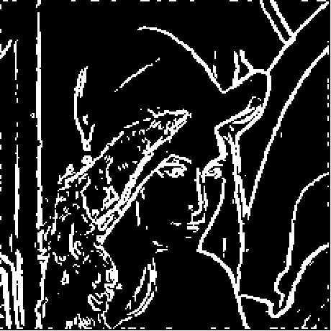
KEYWORDS
Median Filtering : Median filtering is a nonlinear method used to remove noise from images. The median filter works by moving through the image pixel by pixel, replacing each value with the median value of neighbouring pixels.
Edge Detection : Edge detection is an image processing technique for finding the boundaries of objects within images. It works by detecting discontinuities in brightness. Edge detection is used for image segmentation and data extraction in areas such as image processing,computer vision, and machine vision.

Slide 8
INTRODUCTION
Edge detection is essential for the following applications:
1.object identification
2.image segmentation
3.feature extraction
4. Pattern recognition
Normal edge detecting methods will yield a good performance when dealing with the clear images, i.e image with less or no noise.
The main problem come here when there exist a image with impulse noise then, their performance will be degraded when normal edge detecting methods are used.

Slide 9
INTRODUCTION
Noise remains a ubiquitous and unwanted phenomenon that is inherent to many image acquisition.
The noise in the image is due to fundamental step in image process called image acquisition.
Image acquisition is the action of retrieving an image from the source usually a hardware based source for processing.
In order to remove this type of noise , smoothing filters are often applied to the image to decrease the variance of the noise, in order to preserve as much as possible important details in the image.

Slide 10
INTRODUCTION
Denoising the image still encounter some challenges when faced with high impulse noise that include loss of image details , blurring of the image and unsmoothed edges , which makes the edge detection process more difficult to attain.
The motivation in this is driven by following two rules:
1.Resolve the challenges faced with the denoising methods by keeping as much details as possible , avoid blurring of the image , and preserve the sharper edges associated with boundaries.
2.contend with these challenges even in the presence of high-intensity impulsive noise.

Slide 11
LITERATURE SURVEY
TITLE | AUTHORS | PROBLEM | SOLUTION
[1].A Computational Approach to Edge Detection | J. Canny | To detect edges corrupted by white noise. | Uses Gaussian filtering for smoothing the image, intensity gradient, non-maximum suppression for edge thinning, thresholding and tracking of the edges to ensure edge connectivity and continuity.
[2].Holistically nested edge detection (HED) method | S. Xie, Z. Tu | To detect edges using holistic image training and prediction. | Uses convolutional neural network and is based on image training and prediction Of edges

Slide 12
LITERATURE SURVEY
TITLE | AUTHORS | PROBLEM | SOLUTION
[5]. A survey of edge-preserving image denoising methods. | P. Jain, V. Tyagi | To reduce noise while preserving edges. | Uses Median Filtering to Denoise an image while preserving edges
[20]. Impulse Denoising Using Switching Median Filter | V. V. Khryaschev, A. L. Priorov, I. V. Apalkov, P. S. Zvonarev. | To remove impulsive noise using switching median filter. | This method involves detection of noisy pixels prior to processing, and filtering is applied only to corrupted pixels while leaving uncorrupted pixels intact

Slide 13
Existing Methods
Median Filter
Canny Edge Detection

Slide 14
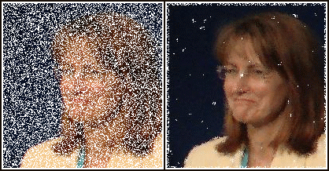
Median Filter
Median filtering is a method used to remove noise from images.
The median filter works by moving through the image pixel by pixel, replacing each value with the median value of neighbouring pixels
It is well suited for removing salt and pepper noise

Slide 15
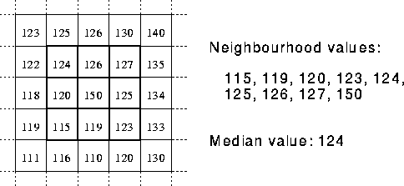

Slide 16
Canny Edge Detection
Canny proposed an approach to edge detection that is optimal for step edges corrupted by white noise. Canny edge detection can be explained in four steps :
Noise Reduction
Gradient Calculation
Non-Maximum Suppression
Edge Thresholding and Hysteresis

Slide 17
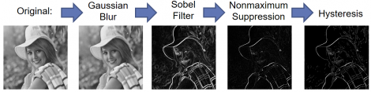

Slide 18
Non-maximum suppression is often used along with edge detection algorithms. The image is scanned along the image gradient direction, and if pixels are not part of the local maxima they are set to zero. This has the effect of suppressing all image information that is not part of local maxima
Edge hysteresis thresholding eliminates edge pixels that are below a certain magnitude that are not adjacent to other edge pixels above a certain magnitude in the edge magnitude image.

Slide 19
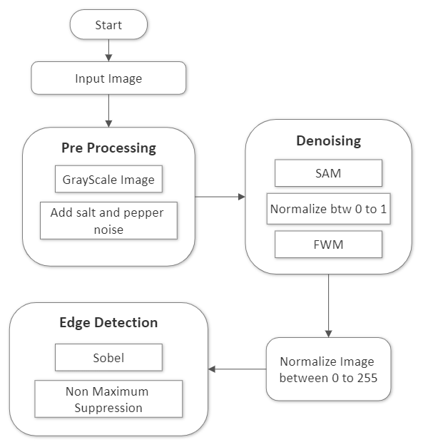
Proposed Approach
The proposed method detects the edges from an impulse noisy image while preserving the edges. This is done in the following steps :
input noisy image
SAMFWM(Switching Adaptive Median Fixed Weighted Mean) Filter
Edge Detection using Sobel operator
Non Maximum Suppression

Slide 20
SAMFWM Filter
Switching Adaptive Median(SAM) is a technique for denoising and it switches between two states of adaptive median filter in which adaptive median filter is flexible and adapts itself to the predefined conditions
Fixed Weighted Mean(FWM) technique for denoising, calculates the averaging weighted mean of neighboring pixels in which the size of the selected window is fixed

Slide 21

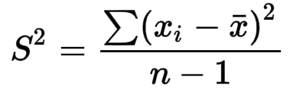
Switching Adaptive Median filter is a denoising filter that switches between the window sizes according to the condition
The difference between pixel values is high when the variance is much higher than the median value ( ), which could be an indication that an edge is present in that area. It thus checks the variance in bigger window sizes to validate whether such an edge does indeed exist or not.
where s = variance of that window

Slide 22
for I_{i,j} ∈ image do
W_{min} Minimum window size (3*3)
W_{max} Maximum window size (5*5)
n zeros(size(I))
for I_{x,y}∈ W, W_{min} ≤ W ≤ W_{max} do
S_{min} Sort(W)
M Median(S_{min})
L Length(S_{min})
V Variance(S_{min})
if L ≠ 0 and V > 2*M then
W W_{max}
S_{max} Sort(W)
M Median(S_{max})
n(i,j) M
I = n
Algorithm of SAM Filter
The minimum window size
is 3 by 3
The maximum window size
is 5 by 5
If the variance of the window
is greater than 2*median then the window size increases to 5 by 5 and the median is calculated

Slide 23
Image after denoising using SAM Filter
Image with impulse noise

Slide 24
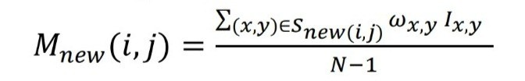
For the Fixed Weighted Mean filtered image, use a 2×2 window in a convolution manner, and check if the pixel being processed is found corrupted
(i.e., I(i,j) =0 or 1 (normalized value))
Using the weights , if salt or pepper is detected, the new processed pixel would be assigned the new value according to below equation. Otherwise, it leaves the pixels unchanged.

Slide 25
for I_{i,j} ∈ image do
W_{2*2} 2*2 Window Size
S Current Window
mean (Σ_{(x,y) in S}I_{x,y})/3
Wmean (Σ_{(x,y) in S}I_{x,y}w_{x,y})/3
sum mean*3
if I_{i,j} = 1 or 0 then
if I_{x,y} = 1 then
count1++
else
count0++
if count1 > count0 then
I_{i,j} mean
else
I_{i,j} Wmean
if sum ≥ 3
I_{i,j} mean
else
I_{i,j} Wmean
else
I_{i,j} I_{i,j}
Algorithm of FWM Filter
assume the corrupted pixel occur (with the assumption that the window contains only 0 and 1). Then the weight is set to w(x,y) = 2 for the east and south pixels and
w(x,y) = 1 for the southeast pixel
If all of the neighboring pixels are equal then the weight is set to w(x,y) = 1 for all pixels.

Slide 26
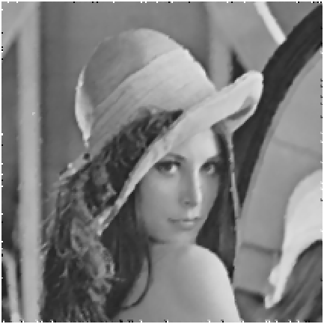
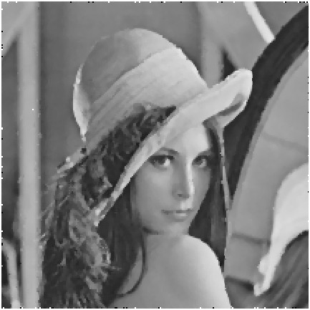
SAM IMAGE
Image after Applying fixed weighted mean filter(FWM) on SAM filtered Image

Slide 27
Thresholding and Edge Detection
After denoising the impulsive noise image using the Switching Adaptive Median and Fixed Weighted Mean Filter, the Image will clear of salt and pepper noise .
The edge detection is performed on the filtered image using the Sobel operator by calculating the gradient over the x direction and y direction

Slide 28
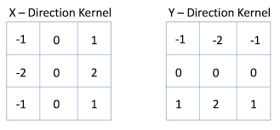
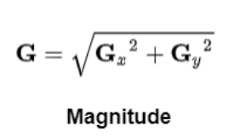
Sobel gradient operator. The gradient of a pixel is a weighted sum of pixels in the 3-by-3 neighborhood. For gradients in the vertical (y) direction and horizontal(x) the weights are:
G_{r}( f(i,j) ) = ( f(i-1,j-1) ) + 2( f(i-1,j) ) + (f(i-1,j+1))-(f(i+1,j-1)) - 2(f(i+1,j)) - (f(i+1,j+1)
G_{c}(f(i,j))=(-f(i-1,j-1) - 2(f(i,j-1)) - f(i+1,j-1)) + (f(i-1,j+1) + 2(f(i,j+1) + (f(i+1,j+1))

Slide 29
Non Maximum Supression
This technique is used for edge thinning in the grayscale image. Edge strength is compared with the neighboring pixels according to gradient direction
The whole process can be summarized as follows:
Calculate the vertical and horizontal gradient.
Calculate the angle of the gradient, and

Slide 30
if the angle of gradient is 0 degree, the gradient magnitude is checked in the east and west directions, and if it is more than the magnitude of pixels in these directions, it is considered on the edge
If the angle of gradient is 45 degrees, the gradient magnitude is checked in the northeast and southwest directions, and if it is more than magnitude of pixels in these directions, it is considered on the edge
if the angle of gradient is 90 degrees, the gradient magnitude is checked in the north and south directions and if it is more than the magnitude of pixels in these directions, it is considered on the edge
if the angle of gradient is 135 degrees, the gradient magnitude is checked in the northwest and southeast directions and if it is more than the magnitude of pixels in these directions, it is considered on the edge

Slide 31
RESULTS
After applying the Switching Adaptive median and fixed weighted mean filter on tha highly impulsive noise image the noise is decreased a lot.
The SAM filter is applied on the whole image whereas the FWM filter is applied on the pixels that are let corrupted after applying the SAM Filter.
This usage of Combination of both filters gives the optimal Noise removed Image.

Slide 32
Image After Applying Switching Adaptive Median Filter on Impulse noise image

Slide 33
Image after Applying fixed weighted mean filter(FWM) on SAM filtered Image

Slide 34
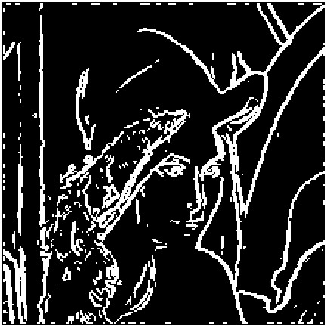
Detection of edges using Sobel operator on SAMFWM filtered image

Slide 35
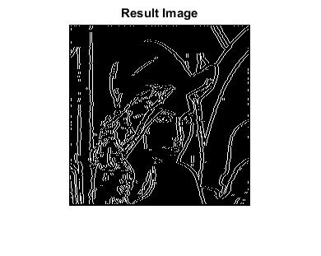
Resulting image after applying Non Maximum Suppression on Sobel Edge Detected Image

Slide 36
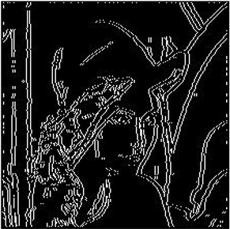
(a)
(b)
(c)
(d)
(e)
Fig : (a) Impulsive noise Image (b) SAM Image (c) FWM Image (d) Sobel Image
(e) Non Maximum Suppression Image

Slide 37
DISCUSSSIONS
The proposed method for denoising the salt and pepper noise is effective even when compared with the existing methods like the Median filter and the Mean filter
Experimental results also show that the proposed SAMFWM is better than the existing methods
The Experimental Results are :
The PSNR ratio of Median filter applied the image is -22.5970
The PSNR ratio of SAMFWM filter applied the image is -22.0736
The SSIM value of Median filter is 0.7746
The SSIM value of SAMFWM is 0.7844

Slide 38
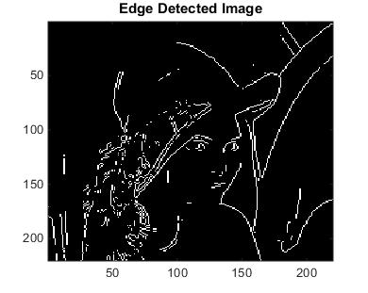
Proposed edge detected image
Canny edge Image
Sobel edge
The existing Canny edge detection method does not preserve edges and also the sobel edge detection gives the thicker edges, While the proposed method gives the optimal result preserving the edges and also having thin edges.

Slide 39
Conclusion
A Robust switching adaptive median (SAM) filtering shrinkage window denoising method has been proposed. The filtered images are assumed to have high correlation with the original images as such edges should track the true routes even under high-intensity impulse noise. To measure the degree of edge preserving and image structural metrics, standard measures are computed in order to compare the performance of different filters including the proposed method to gauge the quality of image after the smoothing process is performed.
Experiments shows that PSNR, SSIM, MSE is high in the proposed algorithm compared to existing. The results obtained proved that the proposed method yielded a better performance after edge detection even in the presence of high intensity impulse noise.

Slide 40
References
[1] J. Canny, “A Computational Approach to Edge Detection,” IEEE Trans. Pattern Anal. Mach. Intell, vol.PAMI-8, no.6, Nov. 1986.
[2] S. Xie, Z. Tu, “Holistically-nested edge detection,” In Proc. IEEE Int. Conf. Comput. Vision, pp. 1395–1403 (2015).
[5] P. Jain, V. Tyagi, “A survey of edge-preserving image denoising methods,” Springer, Inform. Syst. Front. , vol.18, no.1, pp. 159–170, Feb. 2016.
[20] V. V. Khryaschev, A. L. Priorov, I. V. Apalkov, P. S. Zvonarev, “Impulse Denoising Using Adaptive Switching Median Filter,” in Proc. IEEE 2 th Int. Conf. Image process., Sep. 2005.

Slide 41


